Slide 1

Programming Constructs
An implementation view
Amod Malviya
Notes:
Last lecture of the Hardware/Software mini-series

Slide 2
Mindset & Principles
Reasoning >> facts
Thinking is mandatory!
We cannot reason without asking questions. So question!
I will lie!
I will lie only about “facts”, not about “method of reasoning”.
You cannot counter with a looked-up fact. Only reasoning.

Slide 3
Basics

Slide 4
JVM
Thread 1
Heap Memory
pc
Eden
Space
Oldgen
Space
Survivor Space
Stack frames
Local Variable Array
Code Cache
Permgen Space
Operand Stack
References
…
Notes:
Slide on JVM from Lecture 3
JVM gives us only controlled access to memory
OOP is implemented at a JVM level, not just at compiler level
Abstraction prevents understanding

Slide 5


Hardware Review
Decoder
Cache
CPU “thinks” in these terms
PC
Register File
ISA - Instruction Categories
Execution Units
Load / Store
Control flow
Arithmetic & Logical
Notes:
Leaving out a lot of pieces –interrupts, VMM, scheduler, PCIe etc.

Slide 6
All that ISA gives us
Memory - Load / Store
Control Flow – branch, jump, call, return etc.
Arithmetic & Logical - + - * / << etc.
…
Every single higher order programming logic
has to be implemented via these
Notes:
Others – vmm, syscall etc.

Slide 7
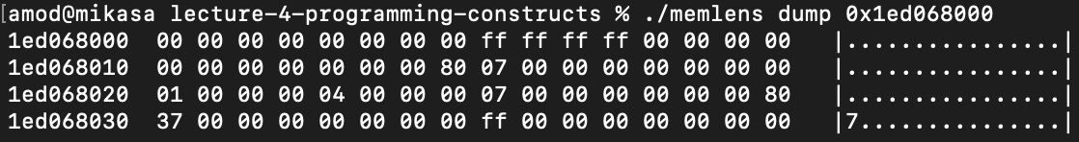
0xff ff ff ff ff ff ff ff
Total addressable memory?
2^64 bytes
Is all memory addressable?
0x0000

Slide 8
0xff ff ff ff ff ff ff ff
Where is the program stored?
Von Neumann Architecture
Machine Code
Machine Code
0x0000
Notes:
Best to not get too stuck with labels

Slide 9
0xff ff ff ff ff ff ff ff
Where is the program stored?
Harvard Architecture
Machine Code
0x0000
Notes:
Harvard vs Modified Harvard
Harvard architecture not as esoteric, see: https://www.nongnu.org/avr-libc/user-manual/pgmspace.html
Assignment: Is JVM a Harvard Architecture?

Slide 10
Functions & Variables

Slide 11
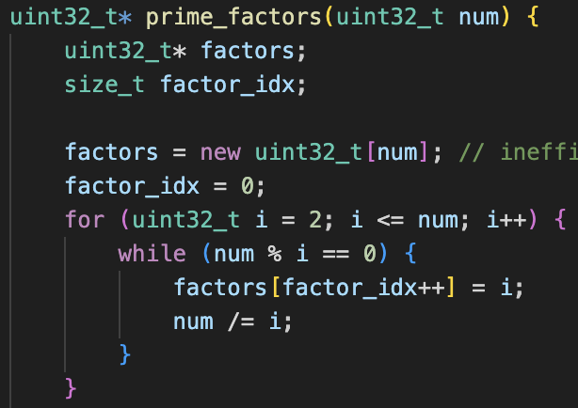
Conceptually – what does the machine code equivalent look like?
File: memlens.cpp
prime_factors
Source code → Machine code
Size of each variable
Address of each variable
Notes:
What’s determinable at compile time vs runtime?
We know the number & type of variables
for/while – implementable with control & arithmetic
Naïve approach: machine code, and for every invocation we “patch” variable values in place
Issues?
For all the variables whose sizes are known, should we place them together?

Slide 12
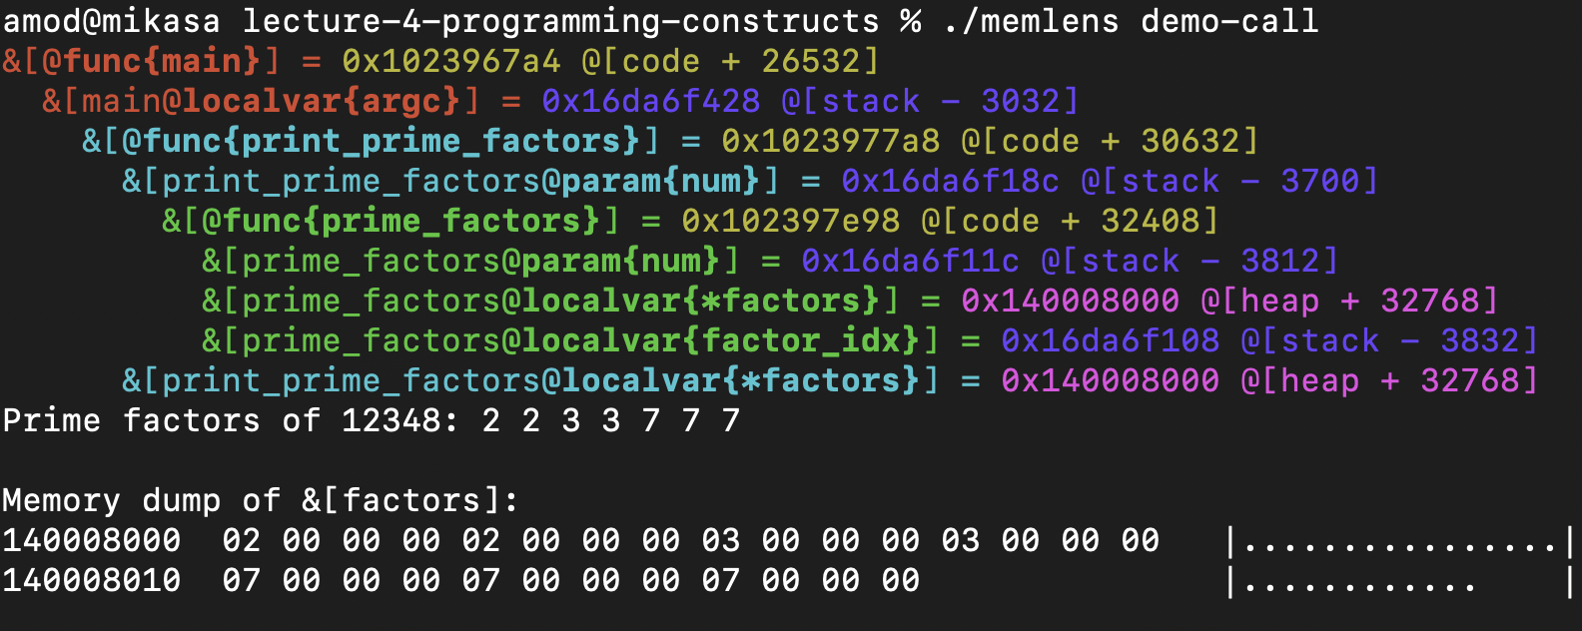
File: memlens.cpp
Stack
Heap
Machine Code
Notes:
Q: What do we see?
Little-endian nature of the data
No names for functions, only addresses
Stack seems to grow downwards, while others grow upwards
All local variables go in the stack
Q: Why should local variables go on the stack?
“new” seems to allocate on the heap
How many such "areas" exist in the memory?

Slide 13
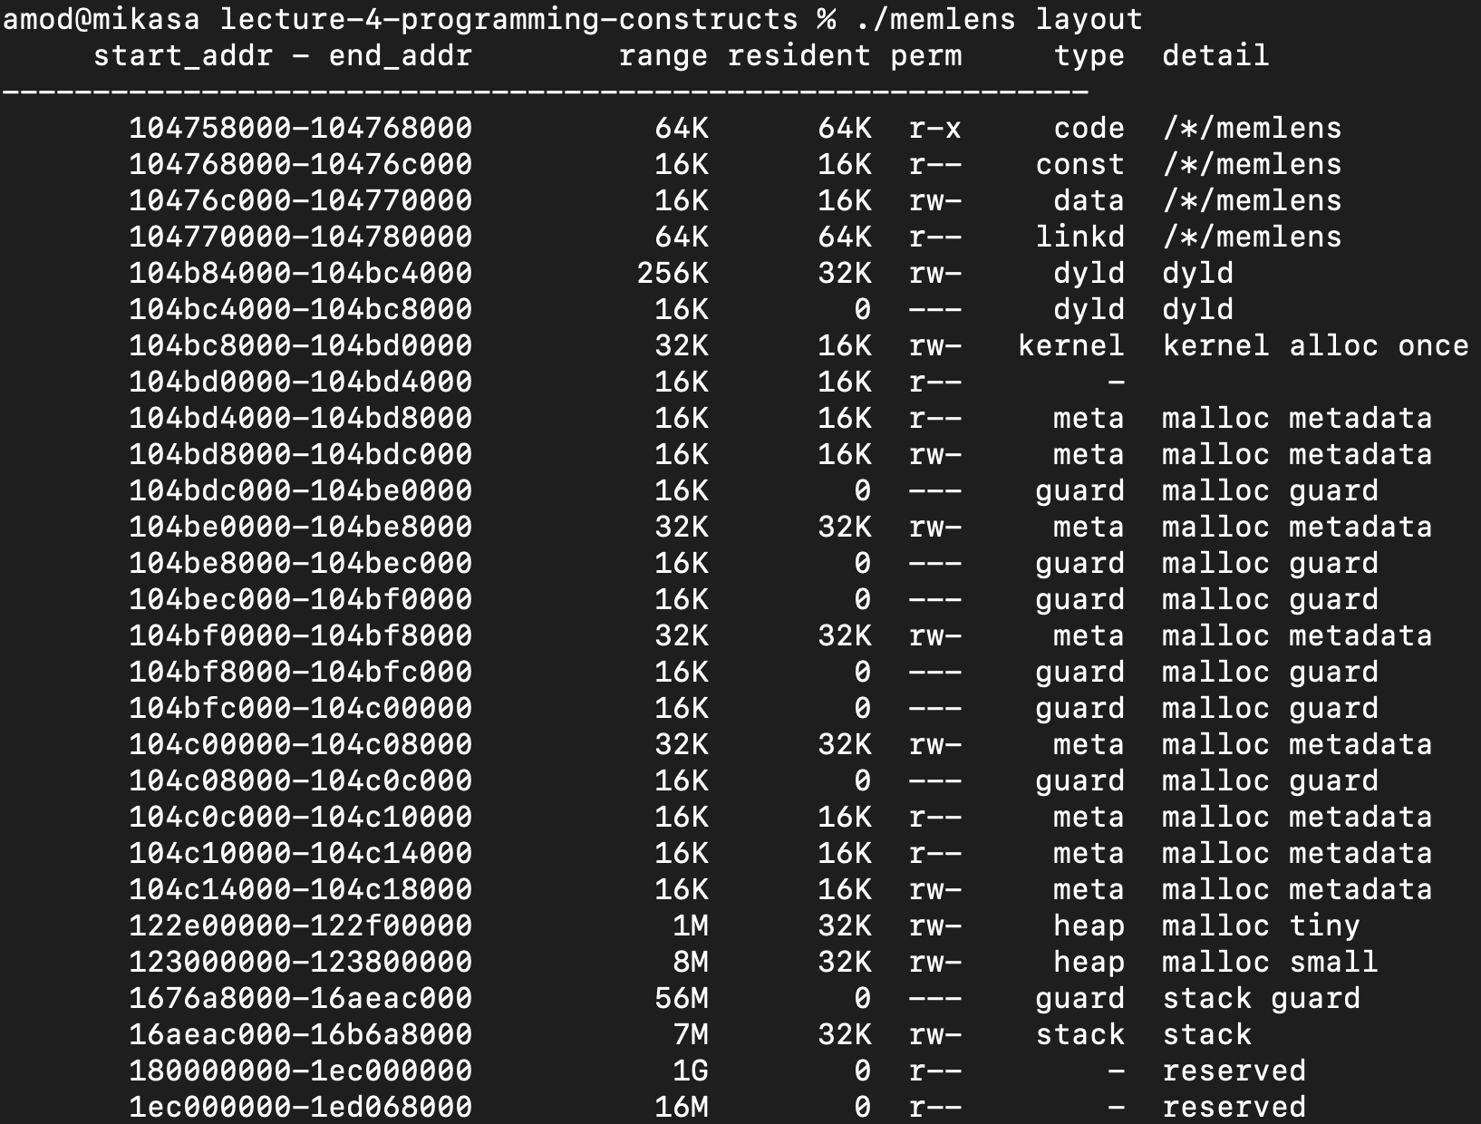
0xff ff ff ff ff ff ff ff
0x0000
Notes:
Anything outside of this range leads to a segfault
These numbers would look different for you for each run – ASLR
Explain rwx
Explain code/const/data/stack/heap

Slide 14
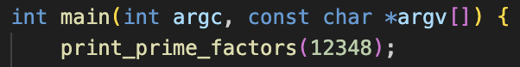
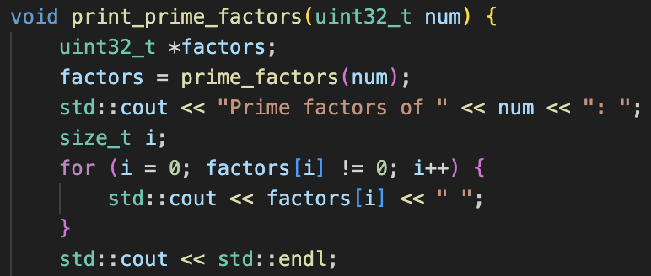
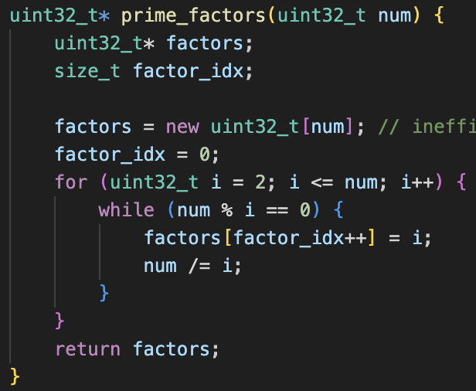
Stack
…
argc (4 bytes)
argv (8 bytes)
… regs … (N bytes)
num (4B)
factors (8B)
… regs … (M bytes)
num (4B)
factors (8B)
factor_idx (8B)
… regs … (P bytes)
i (4B)
Notes:
Pass by value, pass by ref
Lifecycle of the local variable is tied to the stack frame.
Q: How are return values being passed?
Assignment: figure out how non-basic types are returned.
Q: Do you see now why infinite recursion leads to stack overflow?
Q: How is size of the stack determined?
Q: What would happen if variables in stack are too far apart, e.g. in Python.

Slide 15
Default Parameter Values

Slide 16
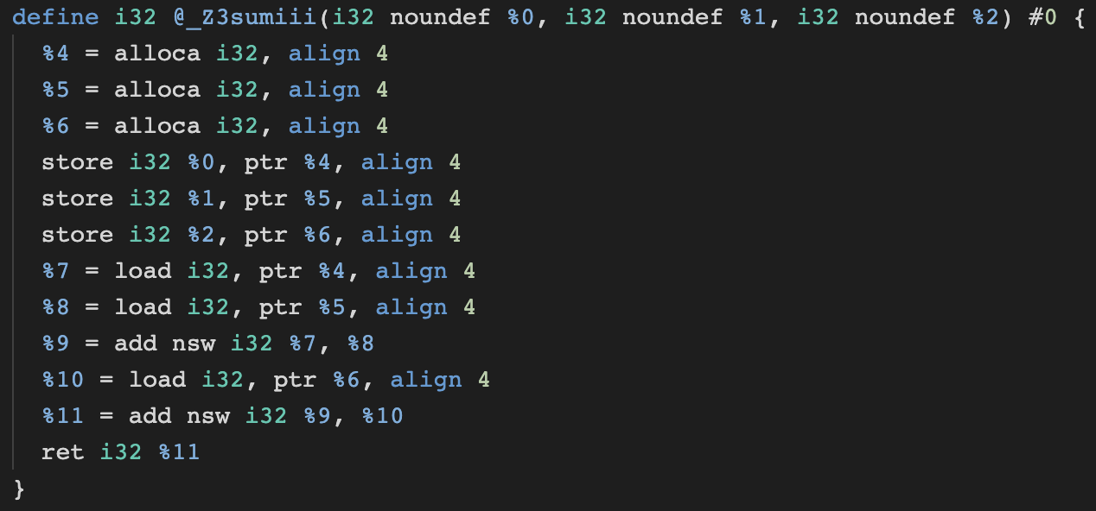
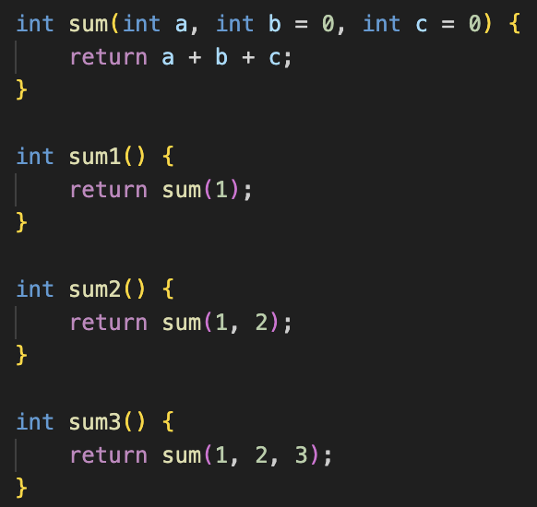
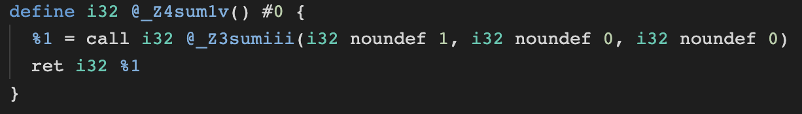
C++
Notes:
Assignment: figure out the $default mechanism in Kotlin

Slide 17
Function Overloading

Slide 18
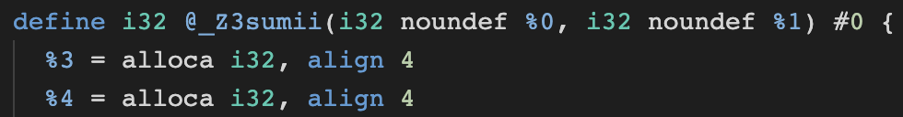
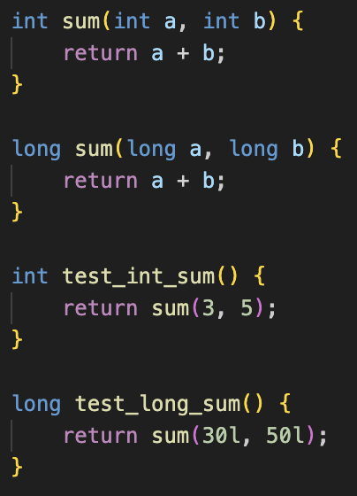
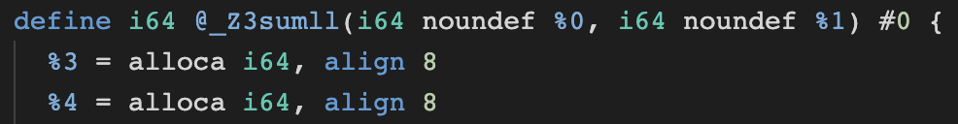
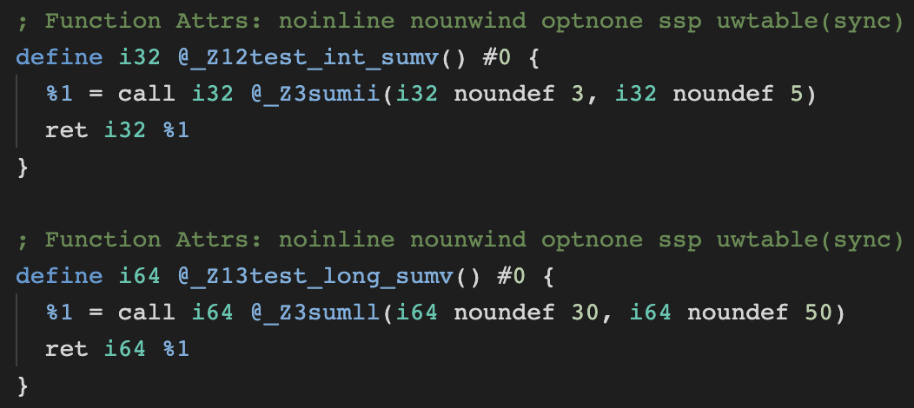

Slide 19
Break
Notes:
Things get flattened out
Everything is addressed via an address

Slide 20
Classes

Slide 21
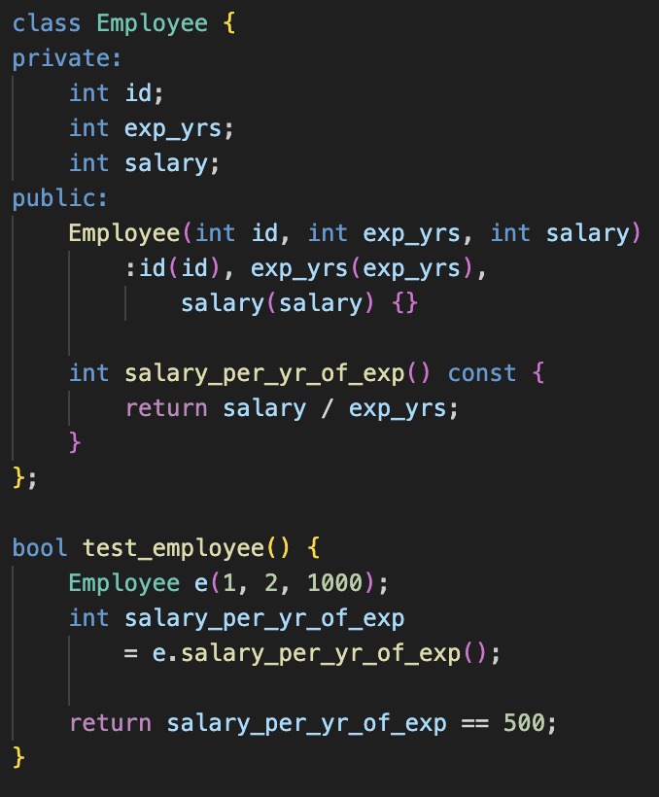
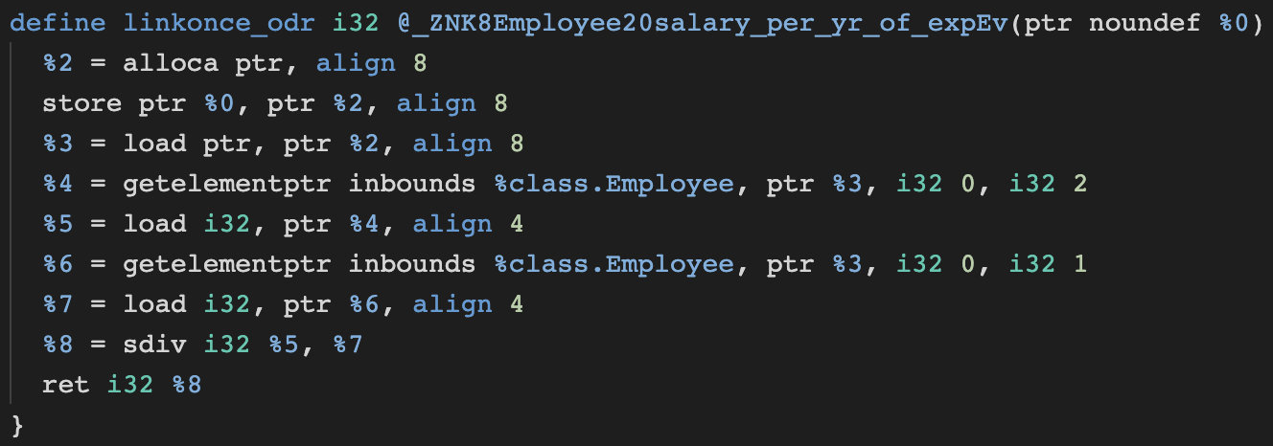
id (4-bytes)
“this” ptr
exp_yrs (4-bytes)
salary (4-bytes)
“this” is just a parameter to a flat function
Notes:
There would also be a function defined for the constructor
Encapsulation is a concept at a compiler level, not at runtime

Slide 22
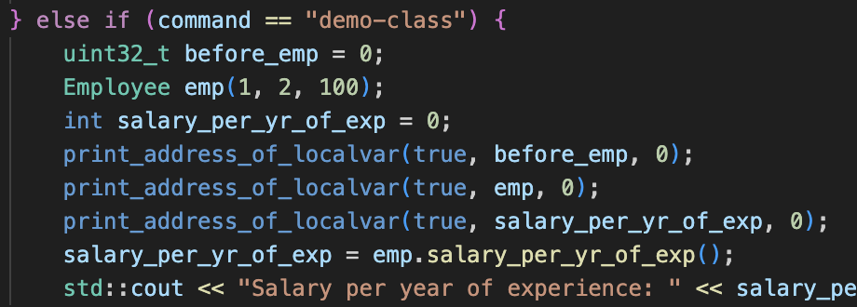
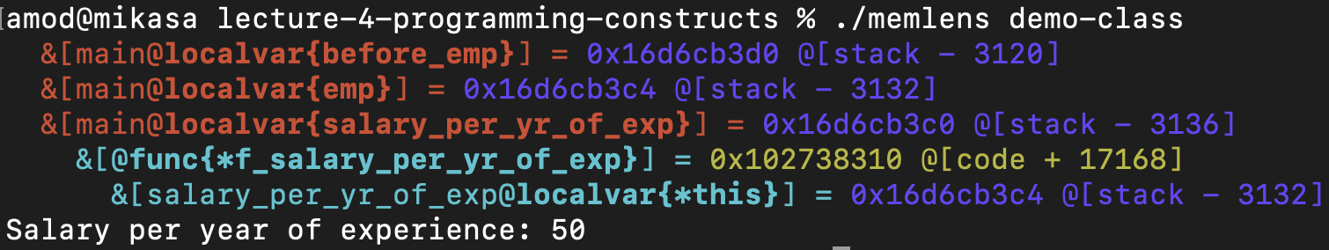
File: memlens.cpp
“this” is just a parameter to a flat function
Notes:
Compare value of “this”
“this” is just a parameter to a flat function

Slide 23
SomeClass::MemberFunc(params)
=
SomeUniqueMemberFunc(this_ptr, …params)
There is no “encapsulation” in machine code
SomeClass::StaticFunc(params)
=
SomeOtherUniqueFunc(params)
Notes:
this_ptr is the address of where the “data” corresponding to the class is stored.

Slide 24
Polymorphism
Notes:
Technically, overriding

Slide 25
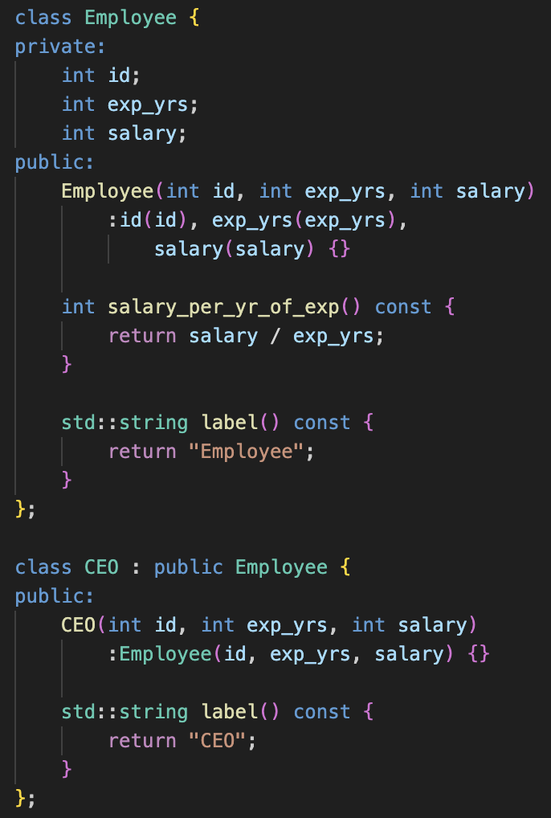
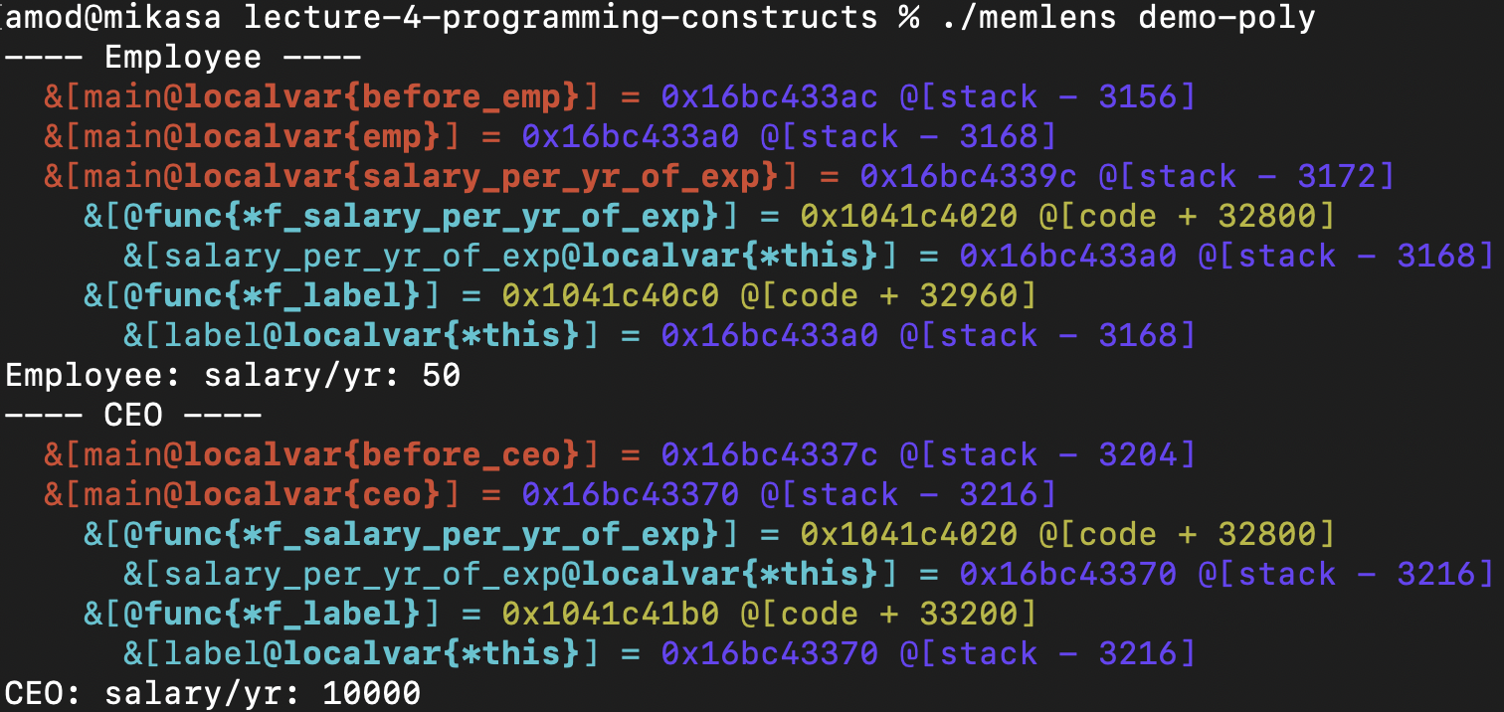
Early binding
Employee emp … emp.salary_per() … emp.label()
CEO ceo … ceo.salary_per() … ceo.label()
Notes:
Q: What are the things you notice?

Slide 26
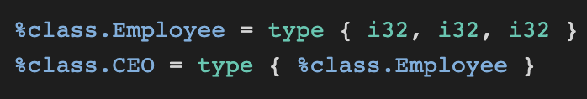
Early binding
id
yrs_exp
Data Area
salary
Employee emp
id
yrs_exp
salary
CEO ceo
Employee::salary_per_year_of_exp
Machine Code
Employee::label
CEO::label
Notes:
Q: When are the green objects created?

Slide 27
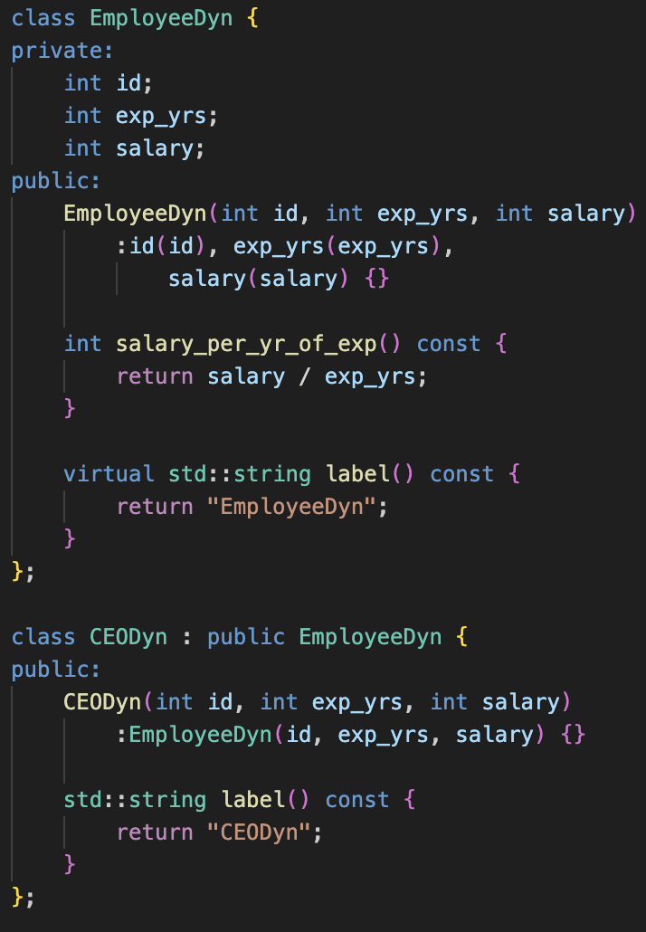
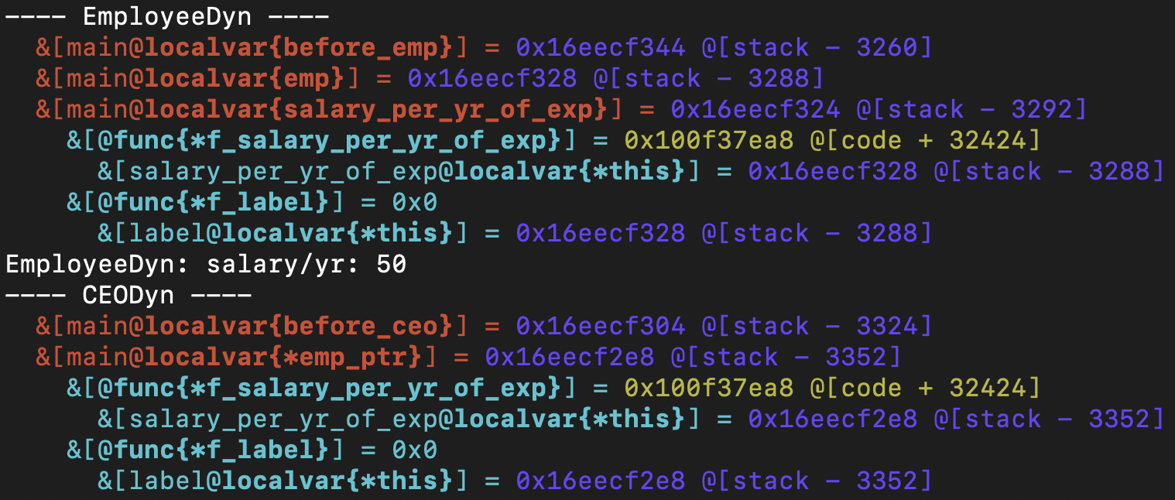
Late binding
Notes:
Q: What things do you notice?
Changes from early binding: 1) Size of object, 2) address of label func

Slide 28
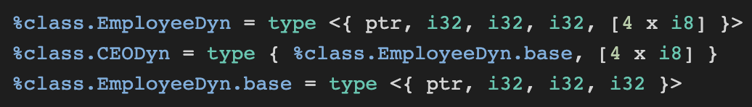
vptr
Late binding
id
yrs_exp
Data Area
salary
vptr
..meta..
id
ptr_func_label
Const Area
yrs_exp
vtable (Employee)
salary
Employee::salary_per_year_of_exp
..meta..
ptr_func_label
Machine Code
vtable (CEO)
Employee::label
Cost:
Trampoline Penalty
CEO::label
Notes:
For each child class of a virtual parent, there’ll be a vtable created
When any instance is created, it’s corresponding vptr is populated based on constructor fn used.
Cost: trampoline penalty

Slide 29
try / catch

Slide 30
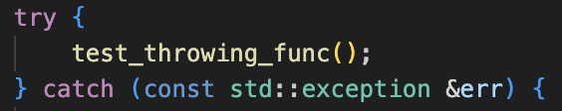
Stack Frames
Code Path
main
execute handler
unwind
has matching catch handler
test_throwing_func
unwind
try/catch exists but no matching handler
throwing_func
throws an Exception
is there a try/catch?
No
throw mechanics are different than return
Notes:
Q: What things stand out?

Slide 31
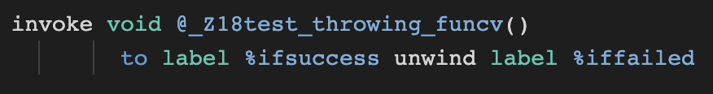
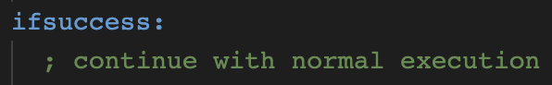
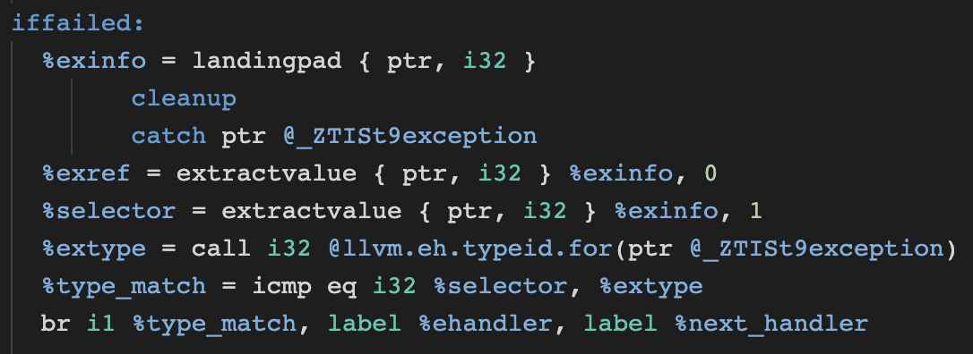
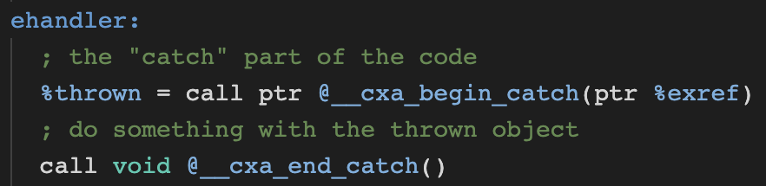
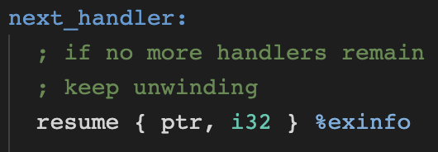
LLVM’s exception handling
get exception structure & selector
match selector
Notes:
Q: how does invoke differs from return?
exref points to RTTI of exception

Slide 32
Dynamic Linking

Slide 33
Process Memory
Compile Time
Run Time
Exec Image
/usr/lib/libc.so… file
Dyn Linked Lib
Linked Libs
libc.so…
printf @0x5718264
GOT
printf 0x00
printf 0x00
GOT
0x5718264
Machine Code
Trampoline
Machine Code
printf@plt (@0x123456) load addr printf@got
call addr printf@got
printf@plt (@0x123456) load addr printf@got
call addr printf@got
call printf
0x123456
call 0x123456
How is address of “printf” resolved?
Notes:
Simplifying a bunch of things here, and a few things would be different from system to system
Q: Cost of trampoline?
GLIBC IFUNC

Slide 34
memlens
Files
memlens.hpp
memlens.cpp
memlens-[linux/windows/macos].hpp
To compile:
linux/macos: make memlens
windows: cl /EHsc memlens.cpp

Slide 35
Summary
Memory Layout – text, data, stack, heap
Variables
Functions
Classes
Polymorphism
try / catch
Dynamic Linking

Slide 36
Thank You

